Slide 1
Read and Write Data
The CF Metadata Conventions (for NetCDF)

Slide 2
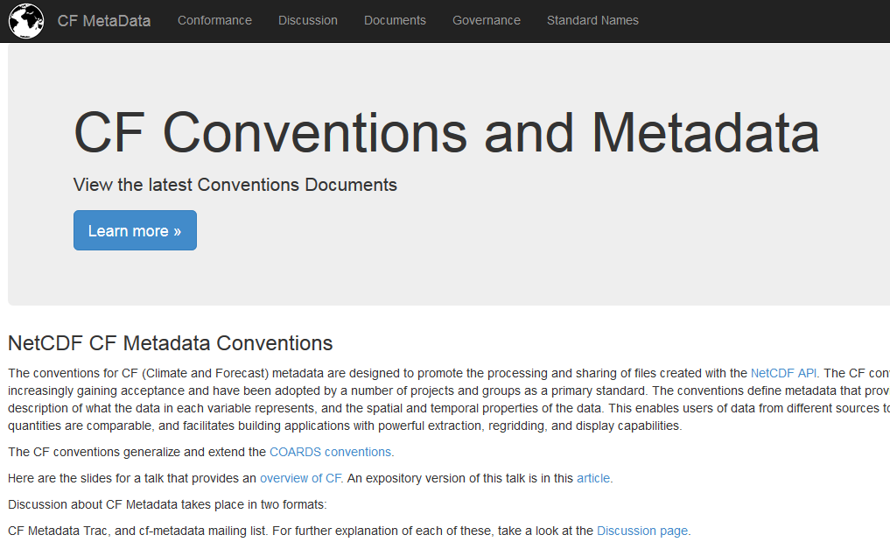
http://cfconventions.org/

Slide 3
Metadata Conventions
Just as we have standard file formats to facilitate data exchange we can also standardize the way we provide metadata.
In the earth system sciences the CF (Climate and Forecast) metadata conventions are an important aid to data sharing and usability.
Notes:
(This slide is self explanatory).

Slide 4
What do the CF metadata conventions allow us to do?
By setting the data in context CF enhances the ability to interpret the data inside netCDF files while still allowing the use of all the standard netCDF tools
Standard software can be used to read and write the metadata
Notes:
By setting the data in context, CF enhances the ability to interpret the data inside netCDF files while still allowing the use of all the standard netCDF tools. You can think of it as an additional layer that sits on top of the netCDF file structure.
Just as having a standard file format allows us to develop software tools for file manipulation, a metadata convention, or standard, means we can develop standard tools which help us to read and write the metadata. This speeds up the process of properly labelling all the data which can seem like a tedious job, but is nevertheless vitally important if you want others to be able to make the best use of your data.

Slide 5
What do the CF metadata conventions allow us to do?
CF metadata can be used to:
find data in an archive ('Discovery' metadata).
provide information necessary to interpreting the data ('Usage' metadata).
control standard data manipulation tools, e.g, for performing mathematical operations or producing visual plots.
Notes:
Once the metadata have been added to a file they can fulfill several important functions.
When trying to locate a particular piece of data in an archive, file names are of course very important. But what if a single file contains several data variables, such as temperature, pressure and humidity and you are only interested in one of those? Or what if the file contains data recorded every hour for a month but you want data for a particular day? You can use the metadata to help you pinpoint exactly the data variables that you need without having to check all the data in the file.
Is the temperature data in the file an instantaneous value, or perhaps a daily mean, a maximum or a minimum? What units is it measured in? This information is needed to correctly interpret the data, for example, knowing whether it is directly comparable with another dataset.
Suppose I have a files containing surface temperature data from several different climate models and I want to calculate the mean, or suppose I want to plot my data on a map? Having metadata that follows the convention means that many of those tasks can be automated.
It is important to understand that standard file formats, metadata conventions and standard software tools together form a powerful scientific toolkit.

Slide 6
Goals of CF (as stated by lead author: Jonathan Gregory)
Locate data in space–time and as a function of other independent variables, to facilitate processing and graphics.
Identify data sufficiently to enable users of data from different sources to decide what is comparable, and to distinguish variables in archives.
Framed as a netCDF standard, but most CF ideas relate to metadata design in general, hence can be contained in other formats such as XML.
Notes:
(This slide is self explanatory)

Slide 7
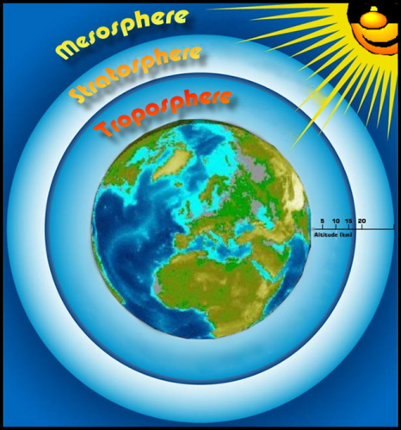
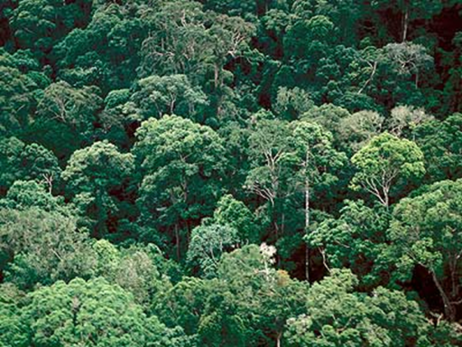
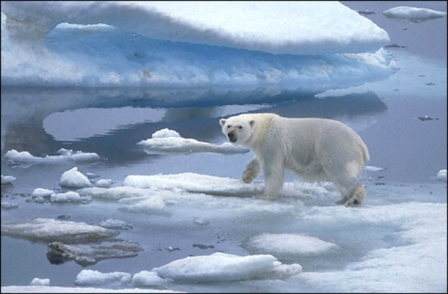
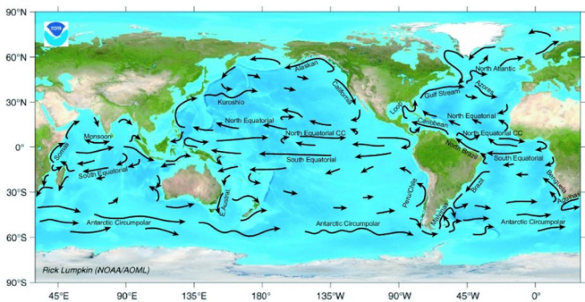
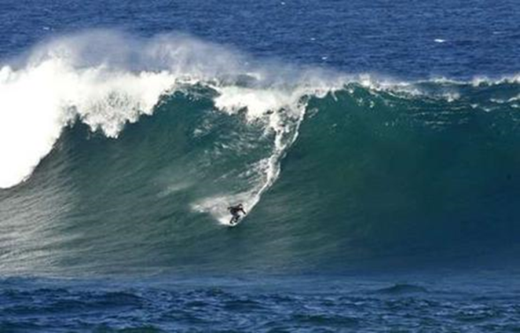
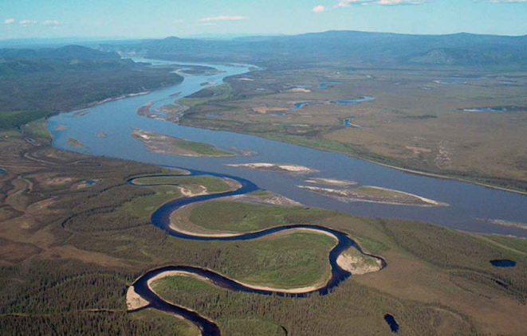
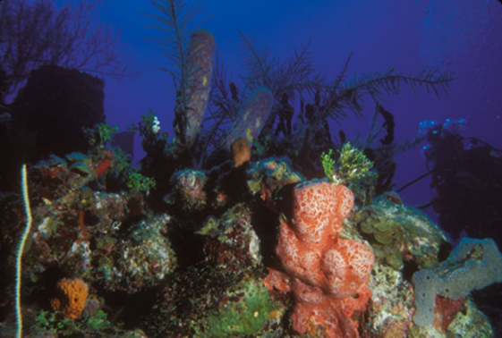
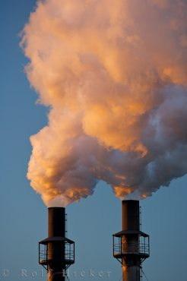
All types of data
Notes:
(This slide is animated so the pictures appear one per mouse click).
The CF conventions now cover the metadata requirements of many scientific areas that are relevant to climate science and weather prediction. Indeed as climate models become increasingly complex and are now sometimes described as 'Earth system models', so the number and range of science areas to which CF is applicable continue to expand. For example, CF metadata can now be used to describe data covering:
1. Atmospheric physics, e.g, the dynamics of the atmosphere, the radiation budget, cloud microphysics, and many more processes.
2. Physical Oceanography
3. Atmospheric chemistry and air quality
4. Ocean biogeochemistry (How small organisms such as plankton and bacteria affect ocean chemistry and vice versa).
5. Land vegetation and it's role in the carbon cycle
6. Cryosphere – both sea ice and land ice.
7. Sea surface waves, for example sell waves, wind driven waves and tides.
8. Hydrology – including precipitation in all its phases, evaporation, and processes such as groundwater runoff and river flow.

Slide 8

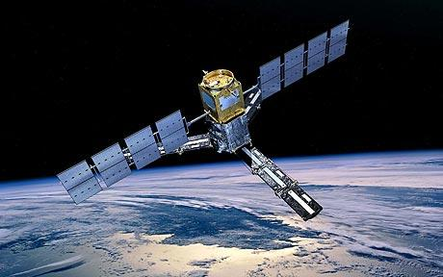
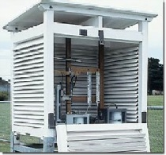
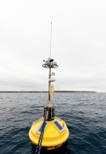
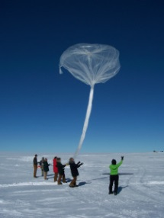
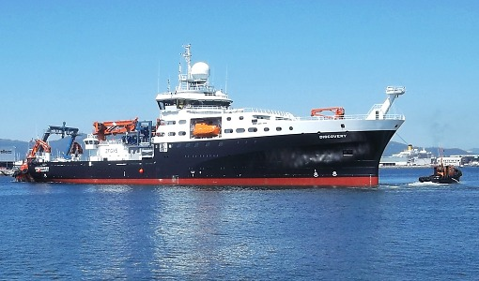

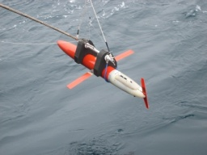
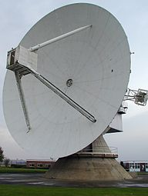
Notes:
(This slide is animated so the pictures appear one per mouse click).
In addition to covering many areas of science relevant to weather and climate, the CF metadata conventions can represent data sets collected in many different ways…
Climate model and Numerical Weather Prediction model data generated on a supercomputer
Satellite data
Weather radar data
Surface weather observations
Research ships
Moored buoys
Radiosondes
Research aircraft
Underwater gliders for measuring pressure, temperature and salinity

Slide 9
Basis of design
Data should be self-describing
Readable by humans and machines
Minimise redundancy
Represented in CDL
Notes:
CF was originally designed in around 2000-2001 by a group of scientists who wanted to share climate model data across the international research community. Not surprisingly, their focus was on describing the sort of datasets that models produce – typically four dimensional data with axes of latitude, longitude, a vertical coordinate such as pressure or height, and a time dimension. The data are arranged on regular grids with coordinate values that increase monotonically and the data tend not to have gaps. Typically, climate model performance is gauged on comparison with observations, such as processed satellite data, that are also presented as global gridded fields. However, the success of CF in enabling data sharing in the world of models quickly led to it's being adapted and extended to describe other types of observational datasets, such as individual satellite swaths or point observations made at scattered locations on the Earth's surface.
COARDS is another metadata convention that was designed for use with geospatial data held in netCDF files. It pre-dates CF. CF was designed to build on practices that had already been established in COARDS. The intention was always to allow the CF conventions to be modified and thus extend the variety of data types that could be described with either COARDS or CF 1.0.
A very important principle in the CF design is the idea that data files should be "self-describing". That is, a file should contain not only the data, but also all the metadata necessary to interpret the data in a scientifically meaningful way without the need to refer to external files, tables, or other information to work out what the data mean. This is particularly important when data are being copied and moved from place to place as it means that the data and documentation can't become separated.
netCDF files are binary files, but using a tool such as ncdump allows the metadata to be extracted in text form. The names of the attributes and their values are designed to be meaningful English words (with US spellings!) so that a human can understand them, for example, "units = kilogram" is a perfectly understandable phrase. Using standard attributes also allows generic software to be developed to make use of the metadata. For example, a program to visualise data by plotting it on a map can readily identify the latitude and longitude coordinates if they are labelled in a standard way.
CF metadata have been developed such that each item of metadata is held in just one place within the file which helps to minimize the file size and also avoids the potential for adding contradictory pieces of information. In the rare cases where the potential for contradiction arises, the conventions stipulate an order of precedence for resolving which attribute values apply to which data variable.
CDL notation is used to represent CF metadata.

Slide 10
The main CF global attributes
conventions E.g.: Conventions = "CF-1.6"
title What's in the file
institution Where it was produced
source E.g. Name of model, instrument
history Audit trail of processing
references Publications, web pages
comment Miscellaneous information
Notes:
"File attributes" are elements of metadata that apply to the file as a whole and therefore to all the data contained within the file. For example, data that all came from the same NWP forecast or were all measured using the same instrument can be gathered together in one file with a single "source" attribute.
The conventions attribute is one of the few compulsory attributes within a CF compliant file. It states which version of the conventions the file uses. Most attributes are optional – you choose to include them if they add useful information about your data, but leave them out if you really don't need them.
All the file attributes in the CF conventions are string valued.
The attributes marked with an asterisk can be attached to individual data variables as well as the file as a whole. This is one of the few examples where metadata redundancy or contradiction is possible. The conventions state that the attribute attached to the individual variable overrides the file attribute of the same name if there is any conflict of meaning.

Slide 11
Variable attributes
standard_name from standard name table
units mandatory unless dimensionless quantity
long_name not standardised
cell_methods variation within a cell e.g. max, mean
cell_measures area or volume of a cell
valid_max, valid_min, valid_range for numeric variables
_FillValue, missing_value CF deprecates missing_value in favour of _FillValue
flag_values, flag_meanings to make "flag" variables self describing
Notes:
The CF conventions describe many possible data attributes and the values they are allowed to take. This presentation can't cover them all, but the next few slides will describe the most frequently used attributes. As with the file attributes, the variable attributes are optional. It is considered "best practice" to make your metadata as complete as possible, so you should include any attributes that will help someone else (or yourself at a later date) to interpret your data, but leave out any that simply don't apply.
"Standard name" gives the name of the geophysical parameter contained in the data variable, such as temperature or pressure. It's value must be chosen from a prescribed list. We'll look at that in more detail in a few slides time.
"Units" describe the unit of measure associated with the standard name. If no unit is included then the data variable is assumed to be a dimensionless quantity, i.e., it is a just a number with no associated physical units.
"Long_name" can be used to name the variable if no appropriate standard name is available, or it can be used to give an alternative description of what the variable contains. It must be a string, but the actual contents of the string can be anything you like.
The "cell_methods" attribute is used to describe any kind of statistical processing carried out at sub-grid scale level to arrive at the data value for a particular point. For example, a temperature value might be representative of a specific location (that is, a "point" value) or it may be a mean value representing the whole area covered by a climate model grid cell, which may be a degree or more in latitude or longitude. Again, we'll look at some particular examples in later.
"Valid_min", "valid_max" and "valid_range" can be used to describe the numerical values you would expect to find within your data. For example, cloud cover values are often expressed as a fraction between zero (meaning clear-sky) and one (meaning completely cloudy). A value of "2" in those circumstances would be regarded as a suspicious data value and you would probably want to exclude it.
"_FillValue" and "missing_value" can be used to indicate points for which there are no data. For example, a variable containing sea ice thickness would have no meaning over the land, so you can mask out land points by giving them a distinctive data value such as -999. To avoid any confusion, the missing data value should not fall within the possible valid_range of real data points.
"Flag_values" and "flag_meanings" are usually used together to describe data where numeric values have been used to represent where a particular condition applies. For example, imagine a satellite dataset in which the data have been used to classify the surface type within each pixel as either "land", "open sea" or "ice_covered". You can assign a number such as 1, 2 or 3 to each of those classifications. Then your data will simply be an array of ones, twos and threes rather than having to use a string to label each point. The flag_values and flag_meanings attributes are used to list the numbers that have been used and explain the meaning of each one.

Slide 12
Coordinate Variables in CF
E.g.:
longitude(longitude)
:units = "degrees_east";
:axis = "X";
:standard_name = "longitude";
Notes:
The COARDS netCDF convention introduced the idea of a special type of variable called a coordinate variable. The CF conventions took this concept and uses coordinate variables that are compatible with COARDS and then also added some extensions to the idea.
Within the netCDF file structure a coordinate variable is a variable like any other, but as the name suggests it is used to provide information about the coordinates, or independent axes, that apply to variables containing the data themselves. For example, model data will typically exist on a fully populated 2-D spatial grid such as, latitude and longitude, with a third geospatial dimension in the vertical. This is illustrated by the diagram.
Coordinate variables have a name and a size, i.e., how many distinct points are labelled along the axis. In CF parlance, the size of the coordinate variable is called its "dimension". The dimensions are declared at the beginning of the netCDF file as shown in the CDL example in the bottom left corner. A dimension has a name and a value, e.g, latitude 360.
A coordinate variable is special in CF metadata because it has the same name as its dimension, e.g. latitude(latitude) and longitude(longitude) as shown in the diagram. The only exception to that rule is if one of the dimensions is declared as UNLIMITED, which allows it to be extended at a later date. Remember that there can only be one UNLIMITED dimension in a netCDF 3 file. Programs such as ncdump and ncgen can recognise that variables named in this way contain coordinate information rather than ordinary data values. Similarly, software written to display CF compliant netCDF files can extract the coordinate information in an automated way and immediately use it to produce a sensible looking plot.
The CF conventions require that coordinate variables have numeric values that either increase or decrease monotonically. This is required for backwards compatibility with COARDS.
However, one of the CF extensions to COARDS is the use of something called "auxiliary coordinate variables" and that is also illustrated on this slide. Auxiliary coordinate variables can be used when there are alternative ways of representing the coordinates along a particular axis. In the slide, the primary coordinate variable in the vertical is sigma – it is identified by having the same name as its dimension. "Sigma" coordinates are a particular kind of vertical coordinate often used in climate and NWP models in which the horizontal levels follow the surface terrain and therefore you don't get the situation where some grid points are actually under the surface in areas of mountainous terrain. However, often modellers simply like to number the levels counting up from the surface to the top of the atmosphere, so another possible vertical coordinate for this dataset would be model level number which is shown on the right. We know it is an auxiliary coordinate variable because although it has the same dimension (sigma) as the main coordinate variable, it has a different name. CF stipulates that there can only be one coordinate variable along any axis of the data, but there is no limit on the number of auxiliary coordinate variables that can share that dimension. There is a metadata attribute called "coordinates" which can be used to show the link between main coordinates and auxiliary coordinates and we'll see an example of that in a later slide.

Slide 13
Time
Time (year, month, day, hour, second) is recorded as:
time_unit since reference_time
e.g. days since 1990-1-1
seconds since 2013-12-31 00:00
2000-2-29 15:00:00 = 36583.625 days since 1900-1-1
Notes:
This slide gives more detail about the use of time as a coordinate variable, which is of course a common requirement in almost every kind of data set.
A time coordinate variable would be declared in the file like any other coordinate variable, having a matching name and dimension such as time(time) or quite commonly, time(unlimited) because often people want to append to their files as more data are gathered over time.
The special thing about the time dimension is its units. It has a standard name of "time" and the canonical unit of time shown in the standard name table is the SI unit of the second, but in fact the picture is rather more complicated than that.
Just as the CF conventions rely on the UDUNITS package for units related processing, they also use it for processing of the time coordinate. This imposes a particular syntax on us of the form "time_unit since reference_time". You can think of the reference time as being the point where the clock started ticking and the choice of what to use generally depends on experimental design, for example, for data gathered at one minute intervals during the day it would make sense to choose midnight of that day as a reference time. For long climate runs everything might be referred to the start of the 20th century. The time_unit is then determined by the frequency of collection of the data points.

Slide 14
Time
To make matters still more complicated, the way the time units are interpreted can also depend on the value of the calendar attribute.
Second and minute are easy to use because the SI system defines the length of the second, and a minute 60 seconds, so choice of calendar doesn't affect those units.
However, sometimes a much larger time unit, such as day or month, is the only sensible choice for your data.
Notes:
(This slide is self explanatory)

Slide 15
Time (using calendars)
E.g. days since 1990-1-1
In the standard 365-day calendar:
2000-2-29 15:00:00 = 36583.625 days since 1900-1-1
In the 360-day calendar used by some climate models:
2000-2-29 15:00:00 = 35058.625 days since 1900-1-1
Beware year and month units!
year = 365.242 days
month = year/12.0
Notes:
(This slide is self explanatory – I hope!)

Slide 16
Calendars
The calendar is indicated by the calendar attribute of the time coordinate variable
Default is to use the "standard" calendar, but it is good practice to always specify a value.
Possible values are:
gregorian or standard (default) | proleptic_gregorian
noleap or 365_day | all_leap or 366_day
360_day | julian
Notes:
(This slide is self-explanatory)

Slide 17
CF Standard Name Table
Currently 4000+ names in the table – and growing!
Updated monthly
Version numbers and date stamp introduced in 2006
Once names are added they are not removed
Notes:
We've seen in some detail how coordinate variables work in CF metadata and they are all important for understanding and interpreting the data. Now lets look in more detail at metadata attributes that apply to the data variables themselves, such as standard_name, units, and so on.
As mentioned in a previous slide, "standard name" gives the name of the geophysical parameter contained in the data variable, such as temperature or pressure. The possible values of the standard name attribute are given in the CF standard name table which is published on the CF website. A list of terms such as CF standard names is referred to as a "controlled vocabulary".
The standard name table is updated on an approximately monthly basis (whereas the CF conventions document tends to be updated less frequently, perhaps once or twice a year).
Each time the table is updated it is given a new version number and a date stamp so that users of the metadata can easily identify which version of the controlled vocabulary was used when a file was created.
New standard names can be requested by individual scientists or on behalf of projects. Once a name is added to the table it remains there in perpetuity, although names can be modified if necessary by making a new version of a name and identifying the old version as an "alias". This avoids the need for data producers to change their metadata just because the standard name has been modified. It would be an unmanageable task for users to repeatedly rewrite potentially thousands of files to make minor changes to the metadata.

Slide 18
CF Standard Name Table: examples
Standard Name
Canonical
Units
AMIP
air_density
kg m-3
air_potential_temperature
K
theta
air_pressure
Pa
plev
air_pressure_anomaly
Pa
air_pressure_at_cloud_base
Pa
Notes:
This is an example of a few entries as they appear in the standard name table. The table shows the name itself and the "canonical units" which is usually, although not always, the SI unit of the quantity identified by the standard name. The last two columns show the equivalent of the standard names using some other controlled vocabularies. For example, "AMIP" is short for Atmospheric Model Intercomparison Experiment. The groups who took part in that project agreed some short names for the parameters they wanted to exchange, but they are considerably less self-explanatory than the CF standard name. "GRIB" is another standard file format that is often used for operational meteorological data exchange, such as sharing weather forecasts between national weather services. GRIB is an official format used by the World Meteorolgical Organisation, but the parameter names are just numbers and the user then has to look up the number in a published table to work out what parameter is actually contained in the data. This is one demonstration of how CF metadata aim to be human readable as well as machine readable.

Slide 19
Canonical units (and standard names)
Canonical_units are agreed at same time as standard name – they go hand in hand, e.g.
mass_concentration → units = "kg m-3"
mole_concentration → units = "mol m-3"
String valued
Must be supported by the Unidata UDUNITS package which converts between recognized units.
Notes:
It's worth saying some more about the canonical units, because they go hand in hand with the standard name. When a new standard name is agreed and added to the table, the units are agreed at the same time. The units are called "canonical" because they set the physical dimensions of a quantity in terms of mass, length, time, temperature, etc. Two quantities that measure something very similar, but do so using different units, would need different CF standard names. For example, if you are measuring the abundance of carbon dioxide in a sample of air and wish to express it in units of kg m-3, the standard name would describe the quantity as a "mass_concentration" whereas the same quantity measured in units of mol m-3 would include the phrase "mole_concentration" in its standard name.
Within the CF metadata inside a netCDF file, the units attribute is a string valued quantity as shown on this slide.
The CF conventions rely on a software package called "UDUNITS" to support the processing of unit information, so the value of the units parameter has to be chosen from a list that is recognized by UDUNITS. In practice, this isn't too restrictive as most of the widely used units are catered for. In fact, the use of UDUNITS allows some flexibility as to which units can be used in a data file because it allows conversion between physically equivalent units. For example, the standard name table says that the canonical unit for any temperature quantity is Kelvin, but temperatures are often measured in other units such as Celsius or Fahrenheit. UDUNITS recognizes those others as equivalent to the canonical unit and knows how to convert between them, so it is fine to record your units as Celsius in your metadata and it saves you having to convert all your measurements to be in Kelvin before you can put them in your data file.

Slide 20
CF compliance checker
A python program to check that the metadata in a netCDF-3 file complies with CF metadata conventions
Available via the web at:
http://puma.nerc.ac.uk/cgi-bin/cf-checker.pl
Select version of conventions to check against
Checks the metadata, NOT the data!
Command line version for batch processing
Notes:
We have reached the end of our introduction to the technical features of netCDF files and the CF conventions and there are just two or three more slides that contain some useful practical information.
For anyone who is producing CF-netCDF files it is important to know about the existence of something called the CF compliance checker. This is a program written in python which takes as its input a CF-netCDF file and, as the name suggests, reads the file and checks whether its structure, the attributes used and the way they have been used is consistent with the CF conventions as they are written.
There are two websites, listed here, which allow a user to check a file on their local computer against any of the versions of the CF conventions.
It is important to remember that the CF checker checks the metadata, but not the data itself. So it won't spot suspicious data values, for example. And it won't spot mistakes such as declaring the units of velocity in metres per second when the data were actually measured in kilometeres per hour, so it is still very much the responsibility of the data producer to check his or her own work and see that it makes sense.
For large numbers of files, there is a version of the CF checker that can be run from the linux command line and work its way through a list of files so that they don't have to be manually checked one by one using a website.

Slide 21
CF - How to get involved
Q: Who are the CF community?
A: Anyone who wants to be!
CF website
http://cfconventions.org/
CF mailing list
http://mailman.cgd.ucar.edu/mailman/listinfo/cf-metadata
For general CF discussion and new standard names
Soon to move to GitHub issues!
Notes:
The last slide finished by talking about the CF community, but who are they?
Anyone who wants to get involved with the development of CF is invited to do so! Usually changes are driven when scientists working on a particular project want to share their data not only with one another but more widely within the research community. If the existing CF conventions don't allow them to fully describe their data then one or more of the project scientists will formulate a proposal for extending the conventions and this will be put forward for open discussion. Changes to CF are agreed by community consensus, although there are procedures in place for breaking a deadlock if consensus can't be reached. CF developments are largely unfunded and depend on interested researchers and data scientists to move things forward.
The central repository for reference material about CF, including the conventions document itself and the controlled vocabularies, is the CF website which is hosted by PCMDI (Program for Climate Model Data Intercomparison) at Lawrence Livermore National Laboratory in California.
There is a very active mailing list which is where most discussions about CF development are held. Anyone can subscribe and questions from both new and experienced users are welcome. The regular contributors are generally very helpful about trying to answer any queries and the discussions are always held in a very professional and courteous manner. New standard name proposals are always discussed and agreed on the mailing list.
Proposals for modification to the conventions document often start life on the mailing list, but as they mature and the discussions become more detailed they usually move to the CF trac system which requires a user account. It can be read through the CF website which also contains instructions on getting an account. For those unfamiliar with trac, it is an open source software product which is useful in managing workflows and projects. New proposals are opened as a "trac ticket" which is then readable by all, and those who have an account can also contribute to the discussion. All the discussion is recorded and trac also allows other documents to be stored so that it is a useful place for developing the precise wording of any changes to the CF document.

Slide 22
Acknowledgements
This presentation draws together material contributed by many people:
CF authors, especially Jonathan Gregory
Software carpentry consortium
Judith Agnew, RAL Space, STFC
The CEDA team
Notes:
All that remains now is to thank all those whose work contributed to the preparation of this presentation to thank you all for listening.

